Slide 1
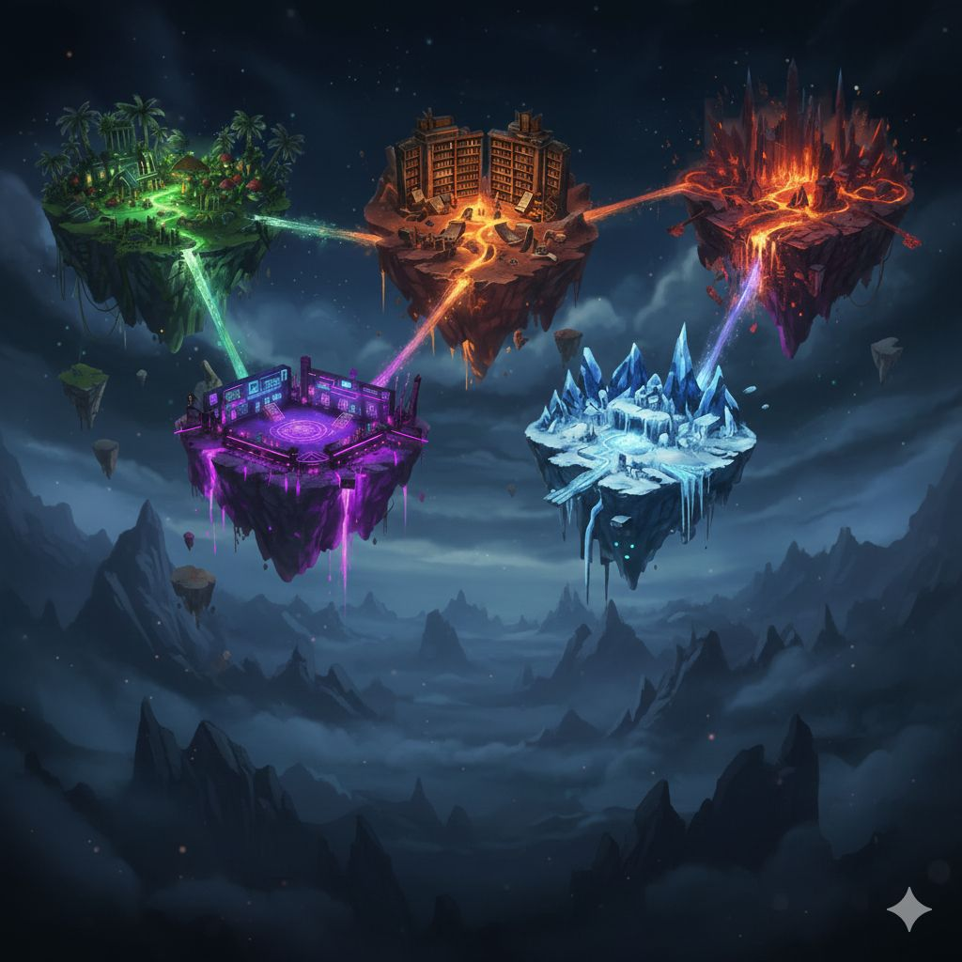




BEYOND THE SCREEN
BEYOND THE
SCREEN
TEAM 11
Giada Napoli (0771315)
Giulia Maltese (0771372)
Mattia Militello (0785287)

Slide 2
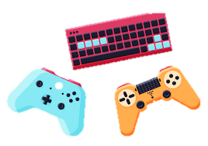
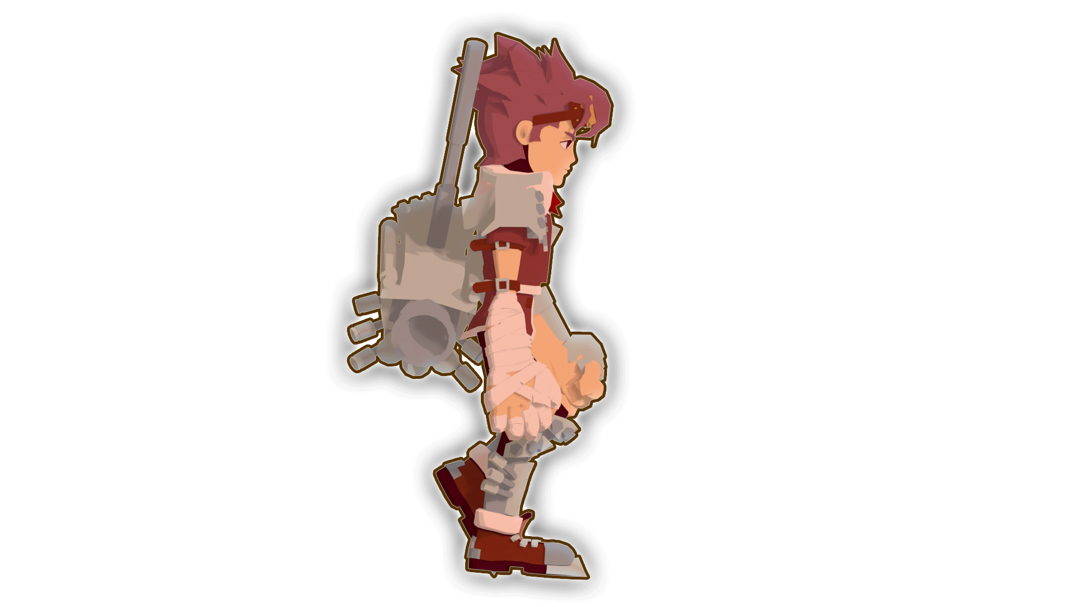
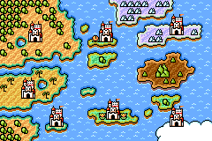
Descrizione
Ingresso nel gioco simil Jumanji.
Il player ha 4 abilità: forza, furtività, resistenza e intelligenza.
Le diverse scelte influenzano la morale del personaggio.
Il player deve affrontare per ogni livello un nemico diverso con delle proprietà singole.
Livelli che vanno ad aumentare di difficoltà.
Armi che cambiano ad ogni livello.

Slide 3

Requisiti Funzionali
User Story | Acceptance Criteria
As a player, I want to create my character by choosing a name and morality so that I have a personalized avatar in the game | -Verify that the player can enter a valid name. -Verify that, if the name is invalid or empty, an error is displayed. -Verify that the player can select initial morality. -Verify that the created character is saved in the system. -Verify that the created character appears correctly in the first level.
As a player, I want a clear and visible life bar so I know how much risk I'm taking. | -Verify that the life bar is always visible. -Verify that the bar decreases when the player takes damage. -Verify that the bar increases when using healing or potions. -Verify that the health bar visual representation never exceeds the maximum capacity or drops below zero
As a player, I want an easy-to-open inventory so I can quickly manage items. | -Verify that the inventory opens by pressing a dedicated key. -Verify that the list of items is legible and up-to-date. -Verify that closing the inventory is immediate.
As a player, I want the game to automatically save changes in abilities or inventory so I always see my character's updated status. | -Verify that every change to abilities saves in real-time. -Verify that every collected item appears immediately in the inventory. -Saving only occurs when there is a real change, not in a continuous loop. -Verify that, after a game restart, abilities have the same values as the last modification made. -In case of a crash, upon opening, the game must restore the data from the last completed automatic save.

Slide 4
Requisiti Non Funzionali
• Game startup time must not exceed 2 seconds.
• Response time to any action must not exceed 100 ms.
• The textual interface must be intuitive.
• The game rules must be understandable without needing to read an external manual.
• The choice options must be clearly visible.
• The game must not suddenly crash if the user inputs an incorrect value.
• In case of a typing error (invalid input), a clear text message explaining the problem must appear.
• The game must run correctly on Windows 11.
• The code must be executable with Python 3.12.
• The text layout must correctly adapt to the VSCode terminal window.

Slide 5
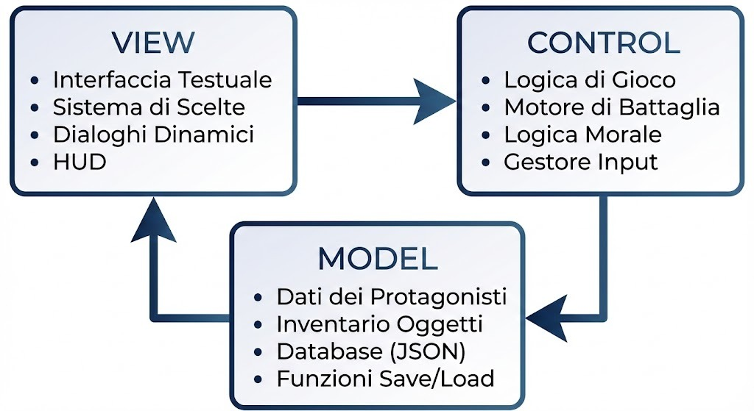
Architettura MVC

Slide 6
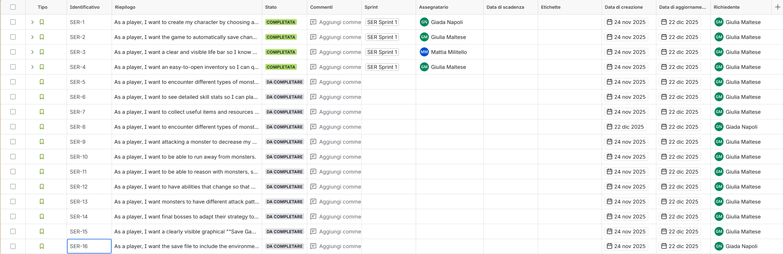
Product Backlog

Slide 7
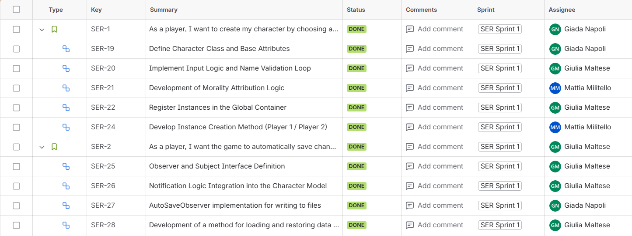
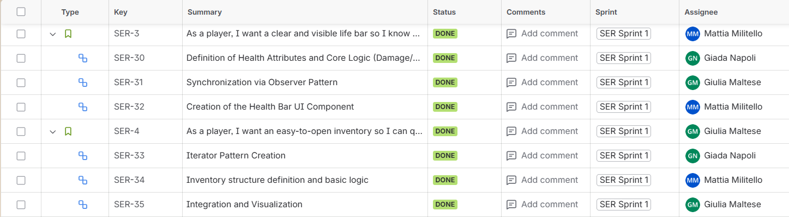
Sprint Backlog
Link Jira

Slide 8
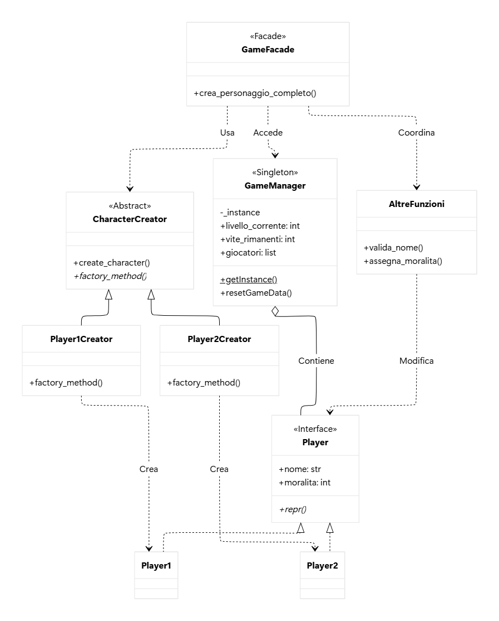

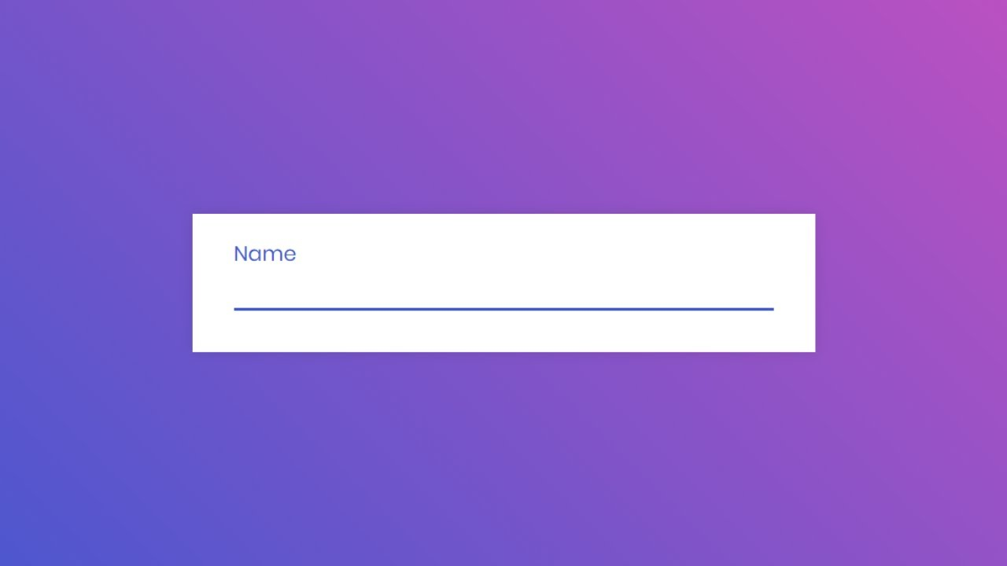

As a player, I want to create my character by choosing a name and abilities so that I have a personalized character in the game

Slide 9
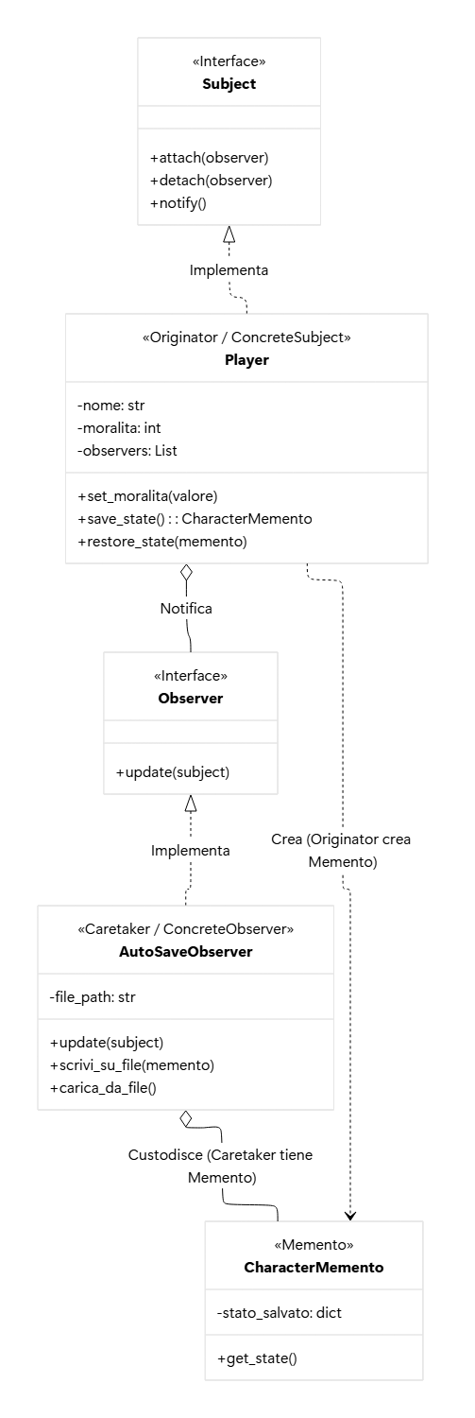
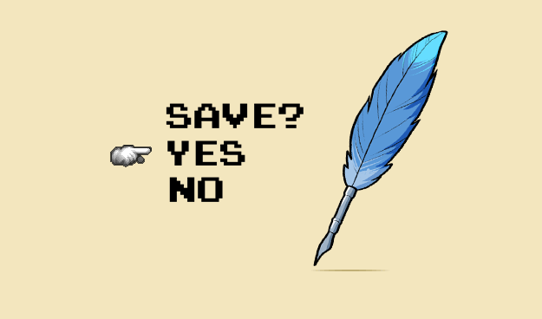
As a player, I want the game to automatically save changes in abilities or inventory so I always see my character's updated status

Slide 10
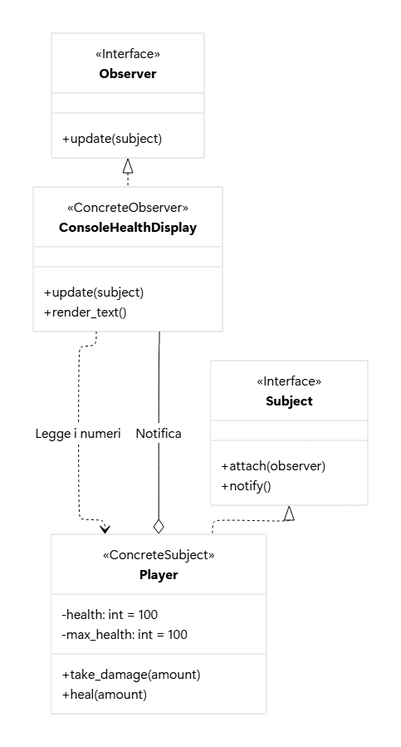
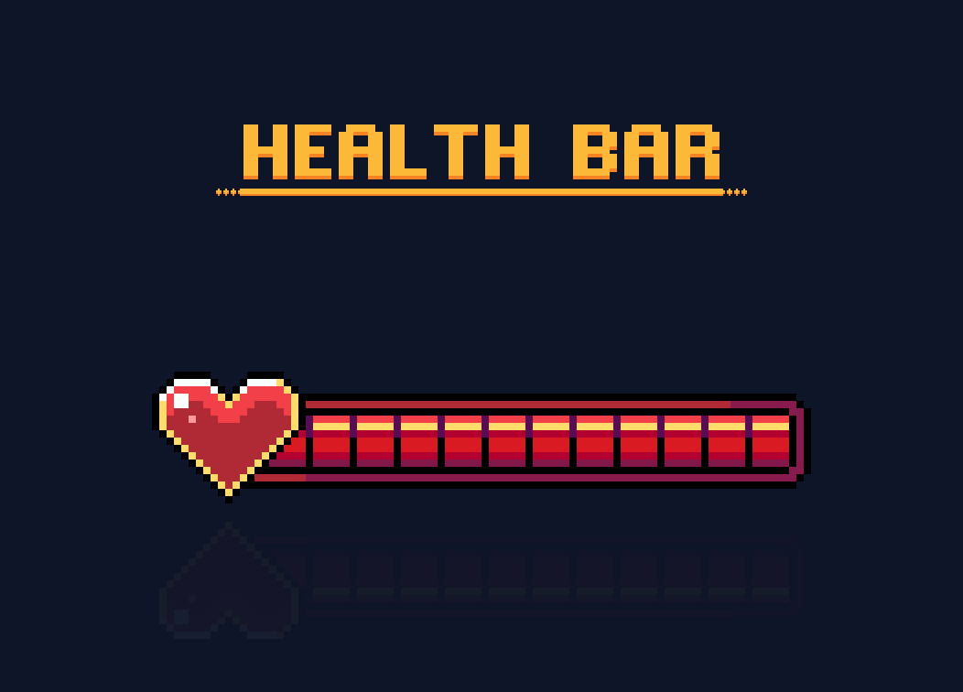
As a player, I want a clear and visible life bar so I know how much risk I'm taking

Slide 11
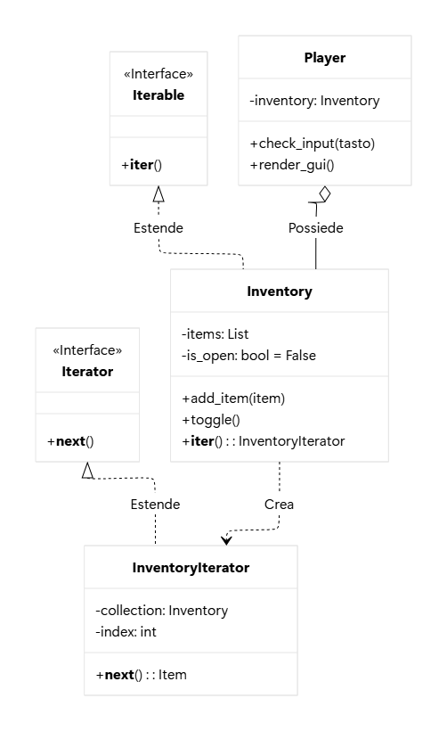
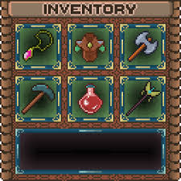
As a player, I want an easy-to-open inventory so I can quickly manage items.

Slide 12

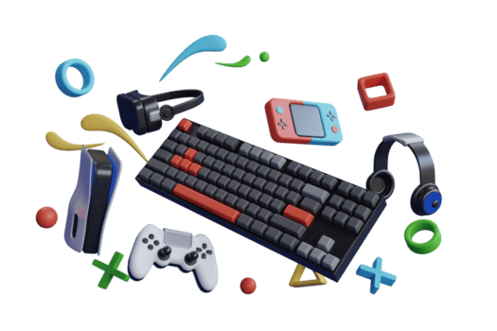
TEST TDD

Slide 13


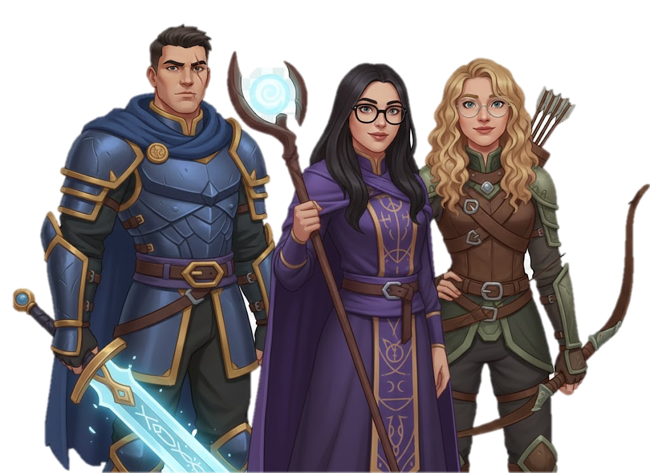
FINE

